Slide 1
Seminar Nanobiotechnologie
B. Sc. Martin Schneider

Slide 2
Waterproof and Tailorable Elastic Rechargeable Yarn Zinc Ion Batteries

Slide 3
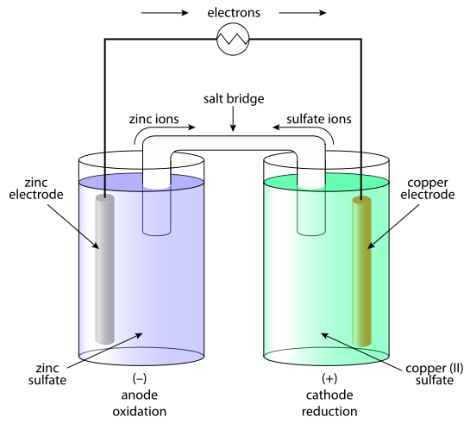
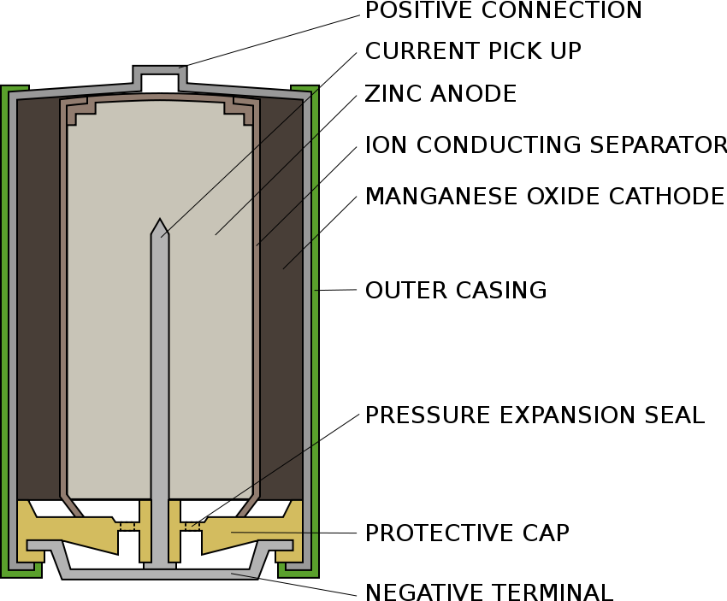
Galvanic Cells
Taylorable Yarn zinc batteries
[URL-3]
[URL-4]

Slide 4
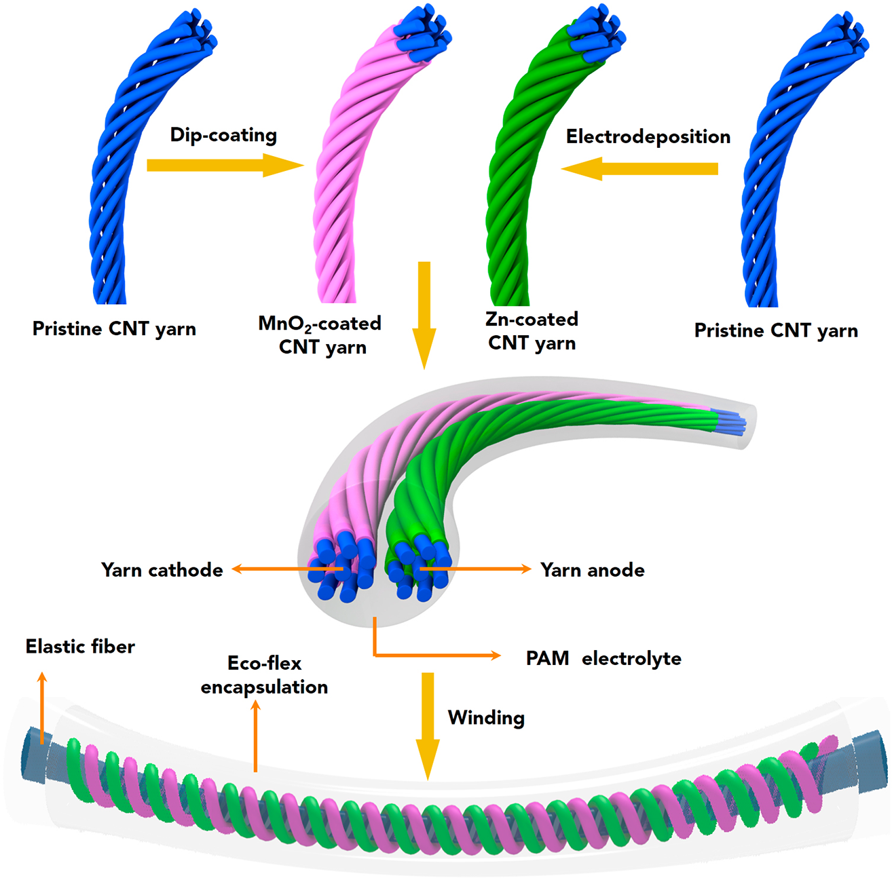
Production process
Taylorable Yarn zinc batteries
Carbon nanotubes
Current collector
Robust
Flexible
Zn - MnO₂ electrodes
Low cost
High specific capacity
Eco-friendly
~100 µm diameter
Hydrogel-matrix
Crosslinked polyacrylamide
Dissolved ZnSO₄ and MnSO₄
High ionic conductivity
Covered by silicone sheath
Li et al., 2018

Slide 5
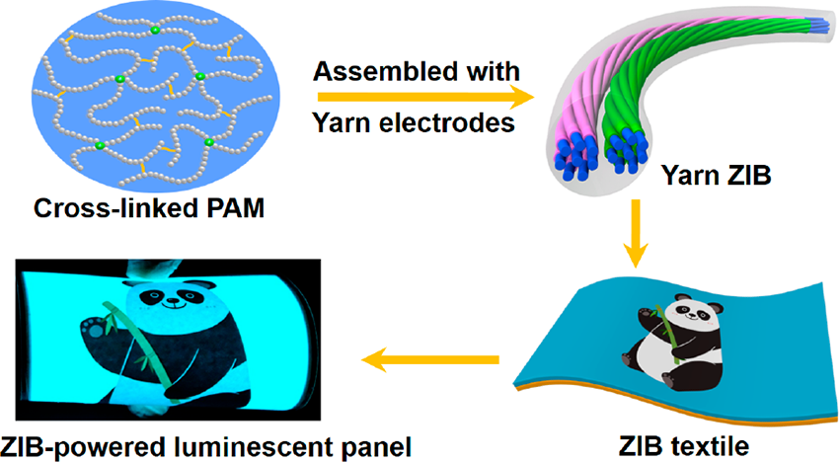
Results
Taylorable Yarn zinc batteries
1,1 m strand powered:
100 LEDs
100 cm² panel
Stable while bending, knotting and stretching
Up to 300 % Strain
High cyling Stability
98.5 % retention after 500 cycles
High waterproof capability
96,5 % retention after 12 h underwater
Li et al., 2018

Slide 6
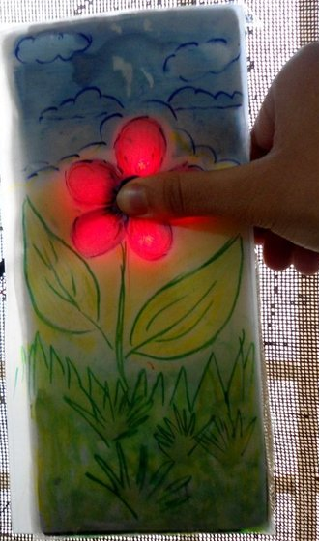
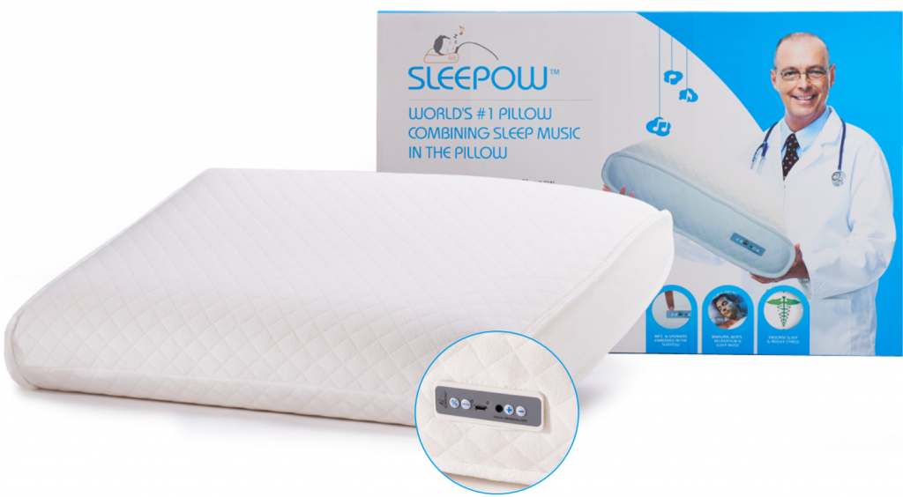
Potential Uses
Taylorable Yarn zinc batteries
Textile-integrated circuits
Wearable Gadgets
Sportswear
(military) uniforms
Pressure Sensors
Implantable medical devices
[URL-1]
[URL-2]

Slide 7
References
Li H., Liu Z. et al.: Waterproof and Tailorable Elastic Rechargeable Yarn Zinc Ion Batteries by a Cross-Linked Polyacrylamide Electrolyte, ACS Nano, Volume 12, Issue 4, 2018
[URL-1]: http://www.sleepow.com/product/sleepow/ (09.06.2018)
[URL-2]: http://www.instructables.com/id/Arduino-controlled-Interactive-wallpiece/ (09.06.2018)
[URL-3]: https://en.wikipedia.org/wiki/Galvanic_cell#/media/File:Galvanic_cell_labeled.svg (10.06.2018)
[URL-4]: https://en.wikipedia.org/wiki/Alkaline_battery#/media/File:Alkaline-battery-english.svg (10.06.2018

Slide 8
Thank you for your attention!

